Slide 1
Final Project Presentation
Library Database Management System
Mason DuPrey, Josh Wilson Shatto, Sam Nagaraj, Keimahrey Bates

Slide 2
Outcomes & Identified Tasks
We wanted to design a program to operate a library self check out kiosk.
The tasks we identified during our initial group discussion:
1. We discussed which task are critical to satisfy user needs. e.g. The program should provide a menu application to let user’s check out and return books from a catalog and client list.
2. We identified the necessary data structures and class definitions that would form the foundation of the backend. e.g. Node, binary search tree, and linked list structures were implemented as class definitions.
3. We chose which Standard Template Libraries could be implemented to streamline the process. The function prototypes we would need were also defined. e.g. <fstream>, <sstream> which were used for file input stream handling.

Slide 3
Project Timelines, and Milestones
Milestone | Deadline
Create Framework | 11/20/2024
Create Text Files for File Streams | 11/23/2024
Create Function Implementations | 11/27/2024
Create Working Draft of Program | 12/02/2024
Create Slide Presentation | 12/04/2024
Finish Final Paper Write Up | 12/08/2024

Slide 4

Mapping Algorithms to Problem Solutions
Reading and writing text files - <fstream> and <sstream> STL was included to use functions like getline( ) to read and condition the data from each text file.
Linked List – To store fstream inputs before being assigned keys
Hash function – Create a key value for each book based on its title to allow for searching a binary tree.
Sorting – Handled by using a Merge Sort Algorithm to sort the linked list in order of key values.
Searching – Balanced Binary Search Tree was created to search through data. O(log n) time complexity achieved.
User Interface – A menu function was created with entry prompts to allow the user to check in and out books.

Slide 5
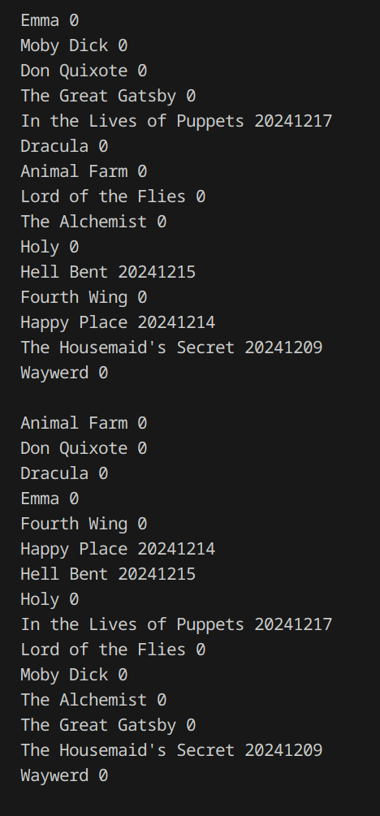
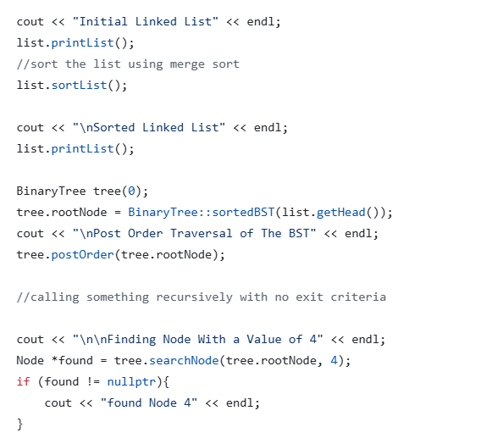
Unit and Integration Test Results
File reading and sorting algorithms were used for integration testing. The text file was read, and an unordered link list was made which was organized in alphabetical order using the merge sort function.
In-line feedback (iostream) output was used to pinpoint errors during run time for unit testing the Binary Search Tree(BST) implementation.
The BST was balanced to achieve O(log n) time complexity for faster performance time. A recursive function and flags were created to handle this issue.

Slide 6
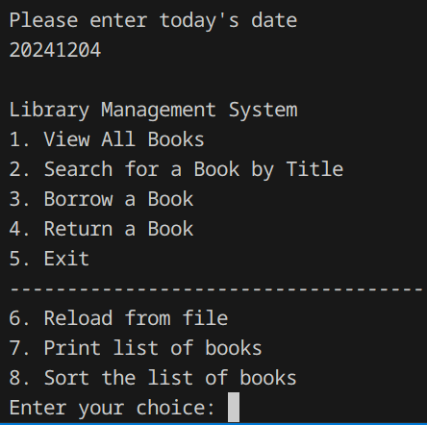
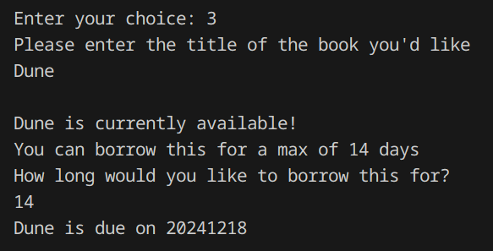
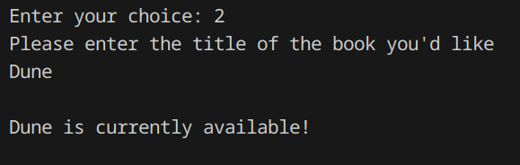
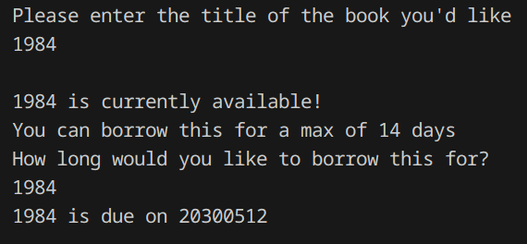
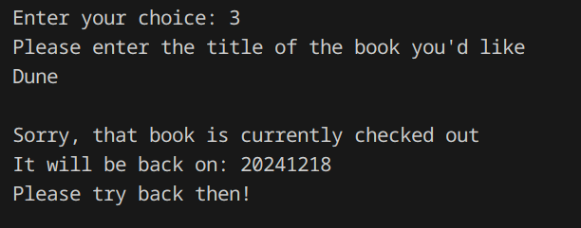
Results – Menu Application
Demonstration of the search and borrow features from the menu application.

Slide 7
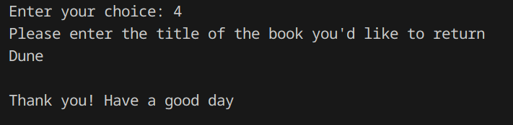
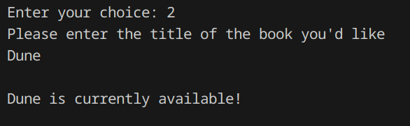
Results continued – Menu Application
Demonstration of the return book feature from the menu application.
Dune Entry is entered into the search to show that it is now available in the inventory again.

Slide 8
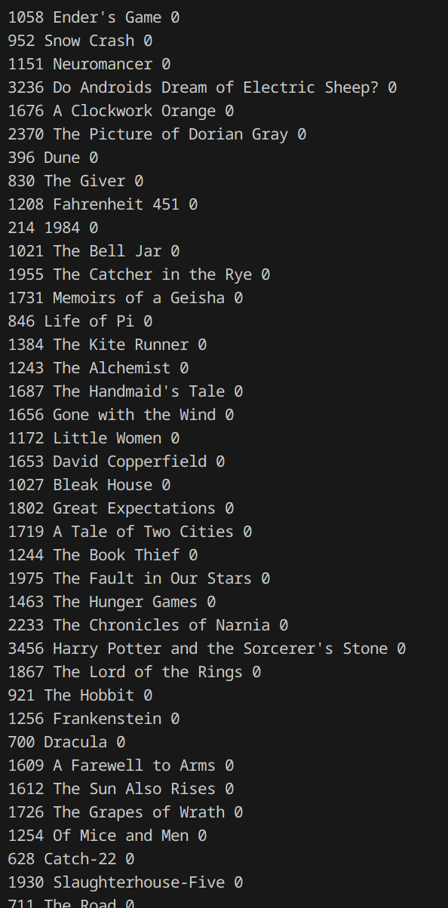
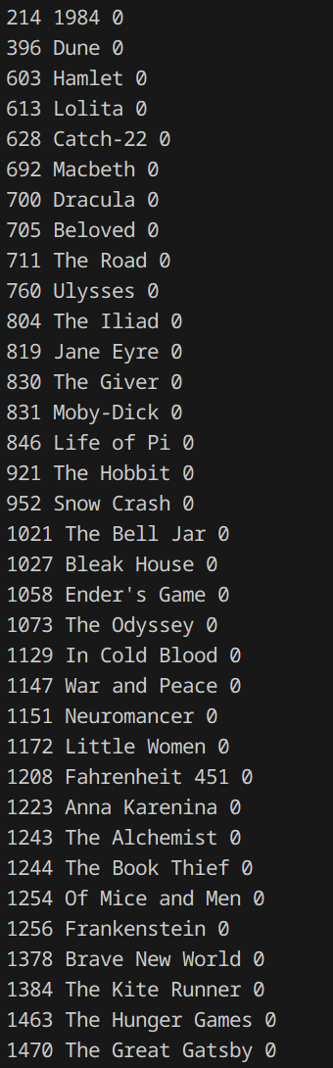
Results continued
The unique hash value was generated and mapped to a specific book title. The unordered link list containing the hash and book title entries were then sorted using the merge sort function to demonstrate that the list can also be sorted with the hash value.
Larger text files were used as input files to ensure the program was capable of handing extensive data sets.

Slide 9
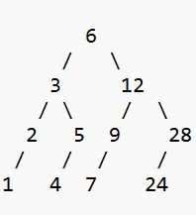
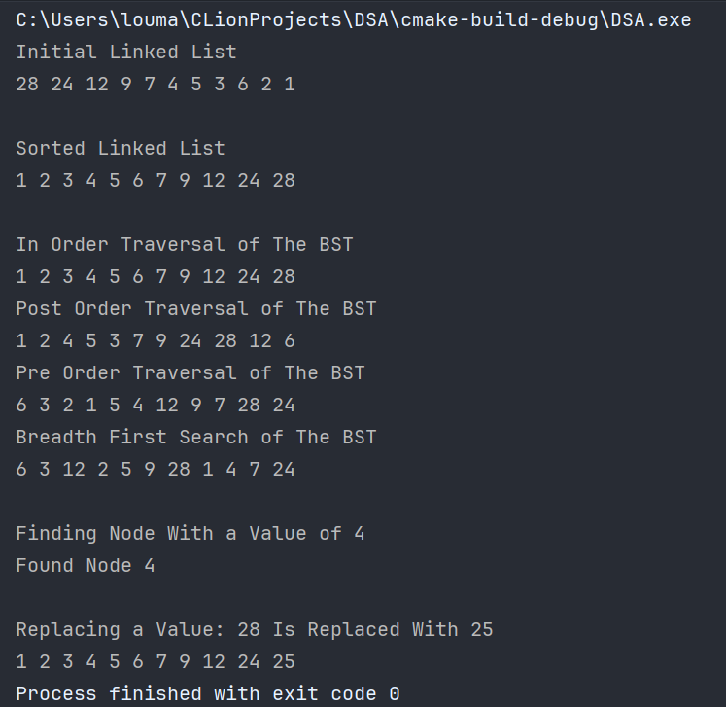
Results Continued
Binary Search Tree is demonstrated using different sorting orders.
Search and Insert functions are demonstrated as well.

Slide 10
Limitations and Improvements
Improvements:
1. The Hash Function could be improved achieve better mapping than the character incrementor we used. The function would allow for a better sorting environment, such as mapping alphabetically.
2. Improve menu application to allow for more options and control over the data structure.
3. Burn Down Chart could display more quantitative information and in-depth breakdown of how we achieved each milestone.
Limitations:
1. Error and exception handling is not robust enough for various entry types.
2. The node structure does not handle conditional initialization of attributes depending on which text file was used as input. This would allow for effective file streaming for different text formats.
3. The current catalog can not be updated without rebooting the program.

